Slide 1
Challenges in implementation of 17th recommendation of DGI
Igor Ivanov
Federal Treasury of the Russian Federation

Slide 2
FISCAL TRANSPARENCY EVALUATION IN 2014
Level of importance | Level of practice
High | Structure of public sector
 | Institutional coverage
 | Stocks coverage
 | Transaction coverage
 | Consistency of data
Medium | Tax expenditures
 | Classification
 | Consistency with previous period data
 | Objectivity of statistic
Low | Periodicity of data during the year
 | Timeliness
 | External audit
 | Dissemination of statistic information
 | Reliability of data
1
Level of practice
Not implemented
Basic practice
Appropriate practice
Advanced practice
¹Russian Federation fiscal transparency evaluation (IMF 2014)

Slide 3
CHALLENGES
coverage of institutions
institutional unit classifier
coverage of stocks
quarterly general government data on an accrual basis
GFS manual 2014 implementation

Slide 4
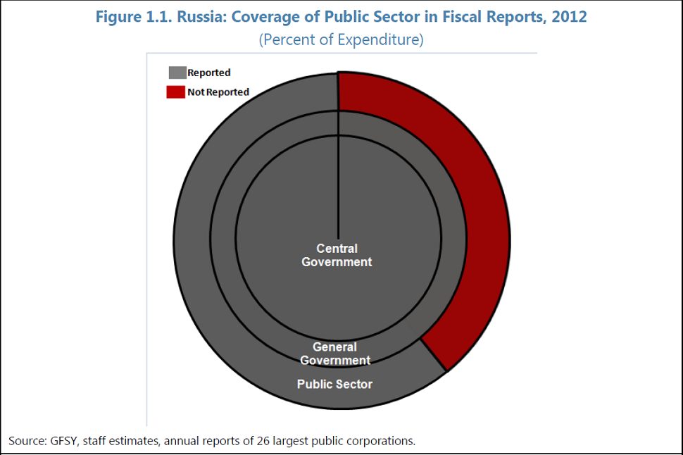
COVERAGE OF INSTITUTIONS
1
¹Russian Federation fiscal transparency evaluation (IMF 2014)

Slide 5
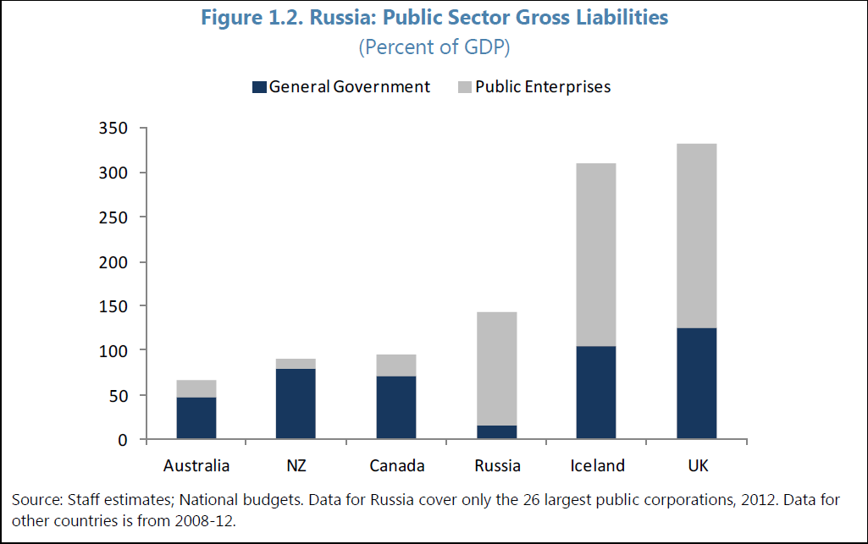
PUBLIC SECTOR GROSS LIABILITIES
1
¹Russian Federation fiscal transparency evaluation (IMF 2014)

Slide 6
CHANGES IN BUDGET CODE
Current budget code of the Russian Federation
Duty of the government to prepare the consolidated budget statement (central, regional and local)
Draft of new budget code of the Russian Federation
Duty of the government to prepare the consolidated financial statement of the public sector

Slide 7



INSTITUTION SECTOR CLASSIFICATION
State unitary enterprise - Moscow subway
Commercial organization
100% Moscow government
50% coverage of costs
profit after deduction of grants from budget

Slide 8
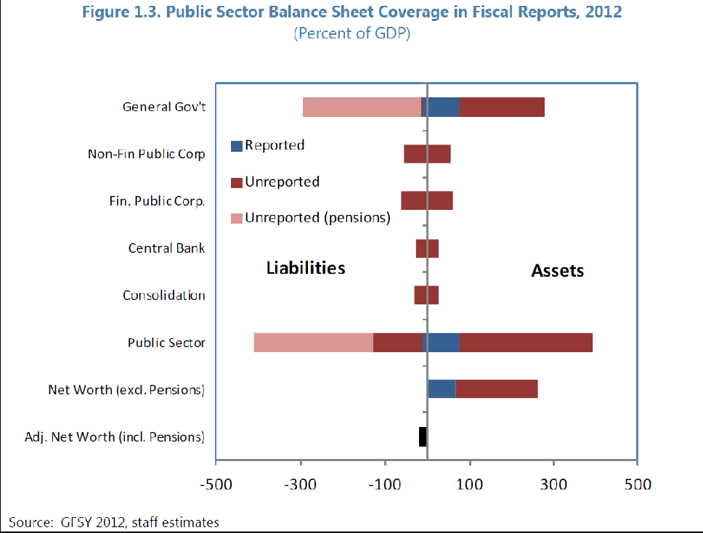
COVERAGE OF STOCKS
¹Russian Federation fiscal transparency evaluation (IMF 2014)

Slide 9
COVERAGE OF STOCKS
subsoil assets
liabilities for pension rights

Slide 10
Quarterly financial balance sheet 2012
Subsectors | Financial assets |  |  |  |  | Liabilities
 | Currency and deposits | Securities other than shares | Loans | Shares and other equities | Other accounts receivable | Shares and other equities | Loans | Other accounts payable
Budgetary units | + | + | + | + | - | + | + | -
Extrabudgetary units | + | + | + | + | - | + | + | -
Social security funds | + | + | + | + | - | + | + | -
State government | + | + | + | + | - | + | + | -
Local government | + | + | + | + | - | + | + | -

Slide 11
QUARTERLY GENERAL GOVERNMENT DATA ON AN ACCRUAL BASIS
The main challenge – other accounts receivable and payable
Changes in legislation
Financial balance sheet of central government for first quartile of 2015

Slide 12
GFS manual 2014 implementation

Slide 13
Thank you for your attention!

